Slide 1
WELCOME CREEC’s 2019 Fundraising Event
Thank You For Celebrating With Us!

Slide 2
With Appreciation
Thank You To Our Generous Sponsors

Slide 3
Fighters for Civil Rights $10,000
Challengers of Discrimination $5,000

Slide 4
Seekers of Justice $2,500

Slide 5
Protectors of Equality $1,000

Slide 6
Advocates for Change $500
Arlene Mayerson ~ Mark Ebel & Catherine Lasky ~ Jocelyn Larkin
Sam Bagenstos & Margo Schlanger ~ Michael Bien
Henry Claypool & Eve Hill ~ Scott La Barre

Slide 7
We’ve Grown!
Immigration Detention Accountability Project – 2018
Accessibility Project - 2019
Nashville Office – 2019
Development Office – 2019

Slide 8
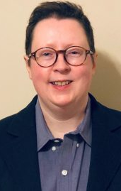
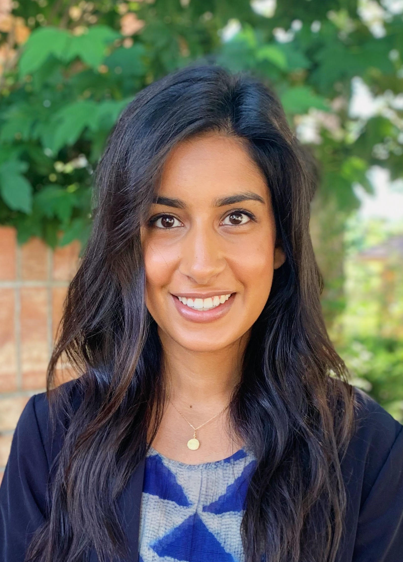
New to CREEC: Liz Jordan: Director of the Immigration Detention Accountability Project Martie Lafferty: Director of the Accessibility Project Julie Yates: Development Director Yashna Eswaran: Paralegal

Slide 9
Where’s CREEC? Denver, Berkeley & Nashville!

Slide 10
CREEC’s expansion was made possible by you! Thank you from our Board of Directors.

Slide 11
Don’t forget the Office Dogs!

Slide 12
Help CREEC continue to grow!
Donate today!
www.creeclaw.org/donate OR text “SupportCREEC” to 44321
Spread the word – forward our E-Newsletter!
Refer clients!

Slide 13
Case Highlights
Here are some of CREEC’s recent cases.

Slide 14
Colorado Springs Agrees to Install over 15,000 Accessible Curb Ramps in the Next 14 Years.
March, 2019
Coming Soon – Boston and San Jose

Slide 15
CREEC Moves for Sanctions Against ICE
May 23, 2019

Slide 16
Accessibility Project
Deaf Inmates Have the Right to Effective Communication Including Access to Videophone Calls.

Slide 17
IDAP: Fighting for the rights of deaf immigrants in detention.

Slide 18
Sign Language Interpreters in Medical Settings
Did you know?
The Americans with Disabilities Act requires doctors and hospitals to provide Deaf people with “effective communication”.
CREEC does and helps others know it, too.

Slide 19
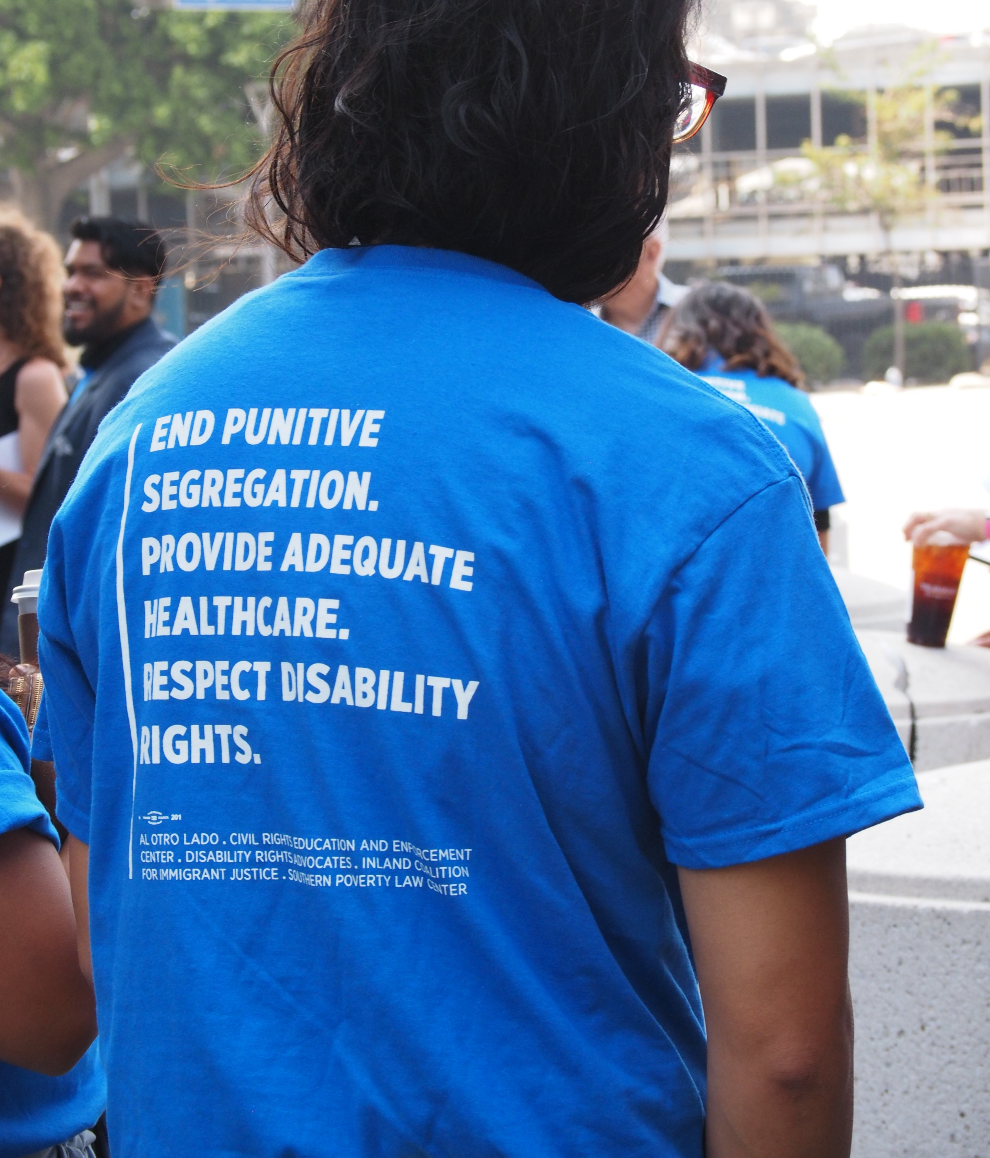
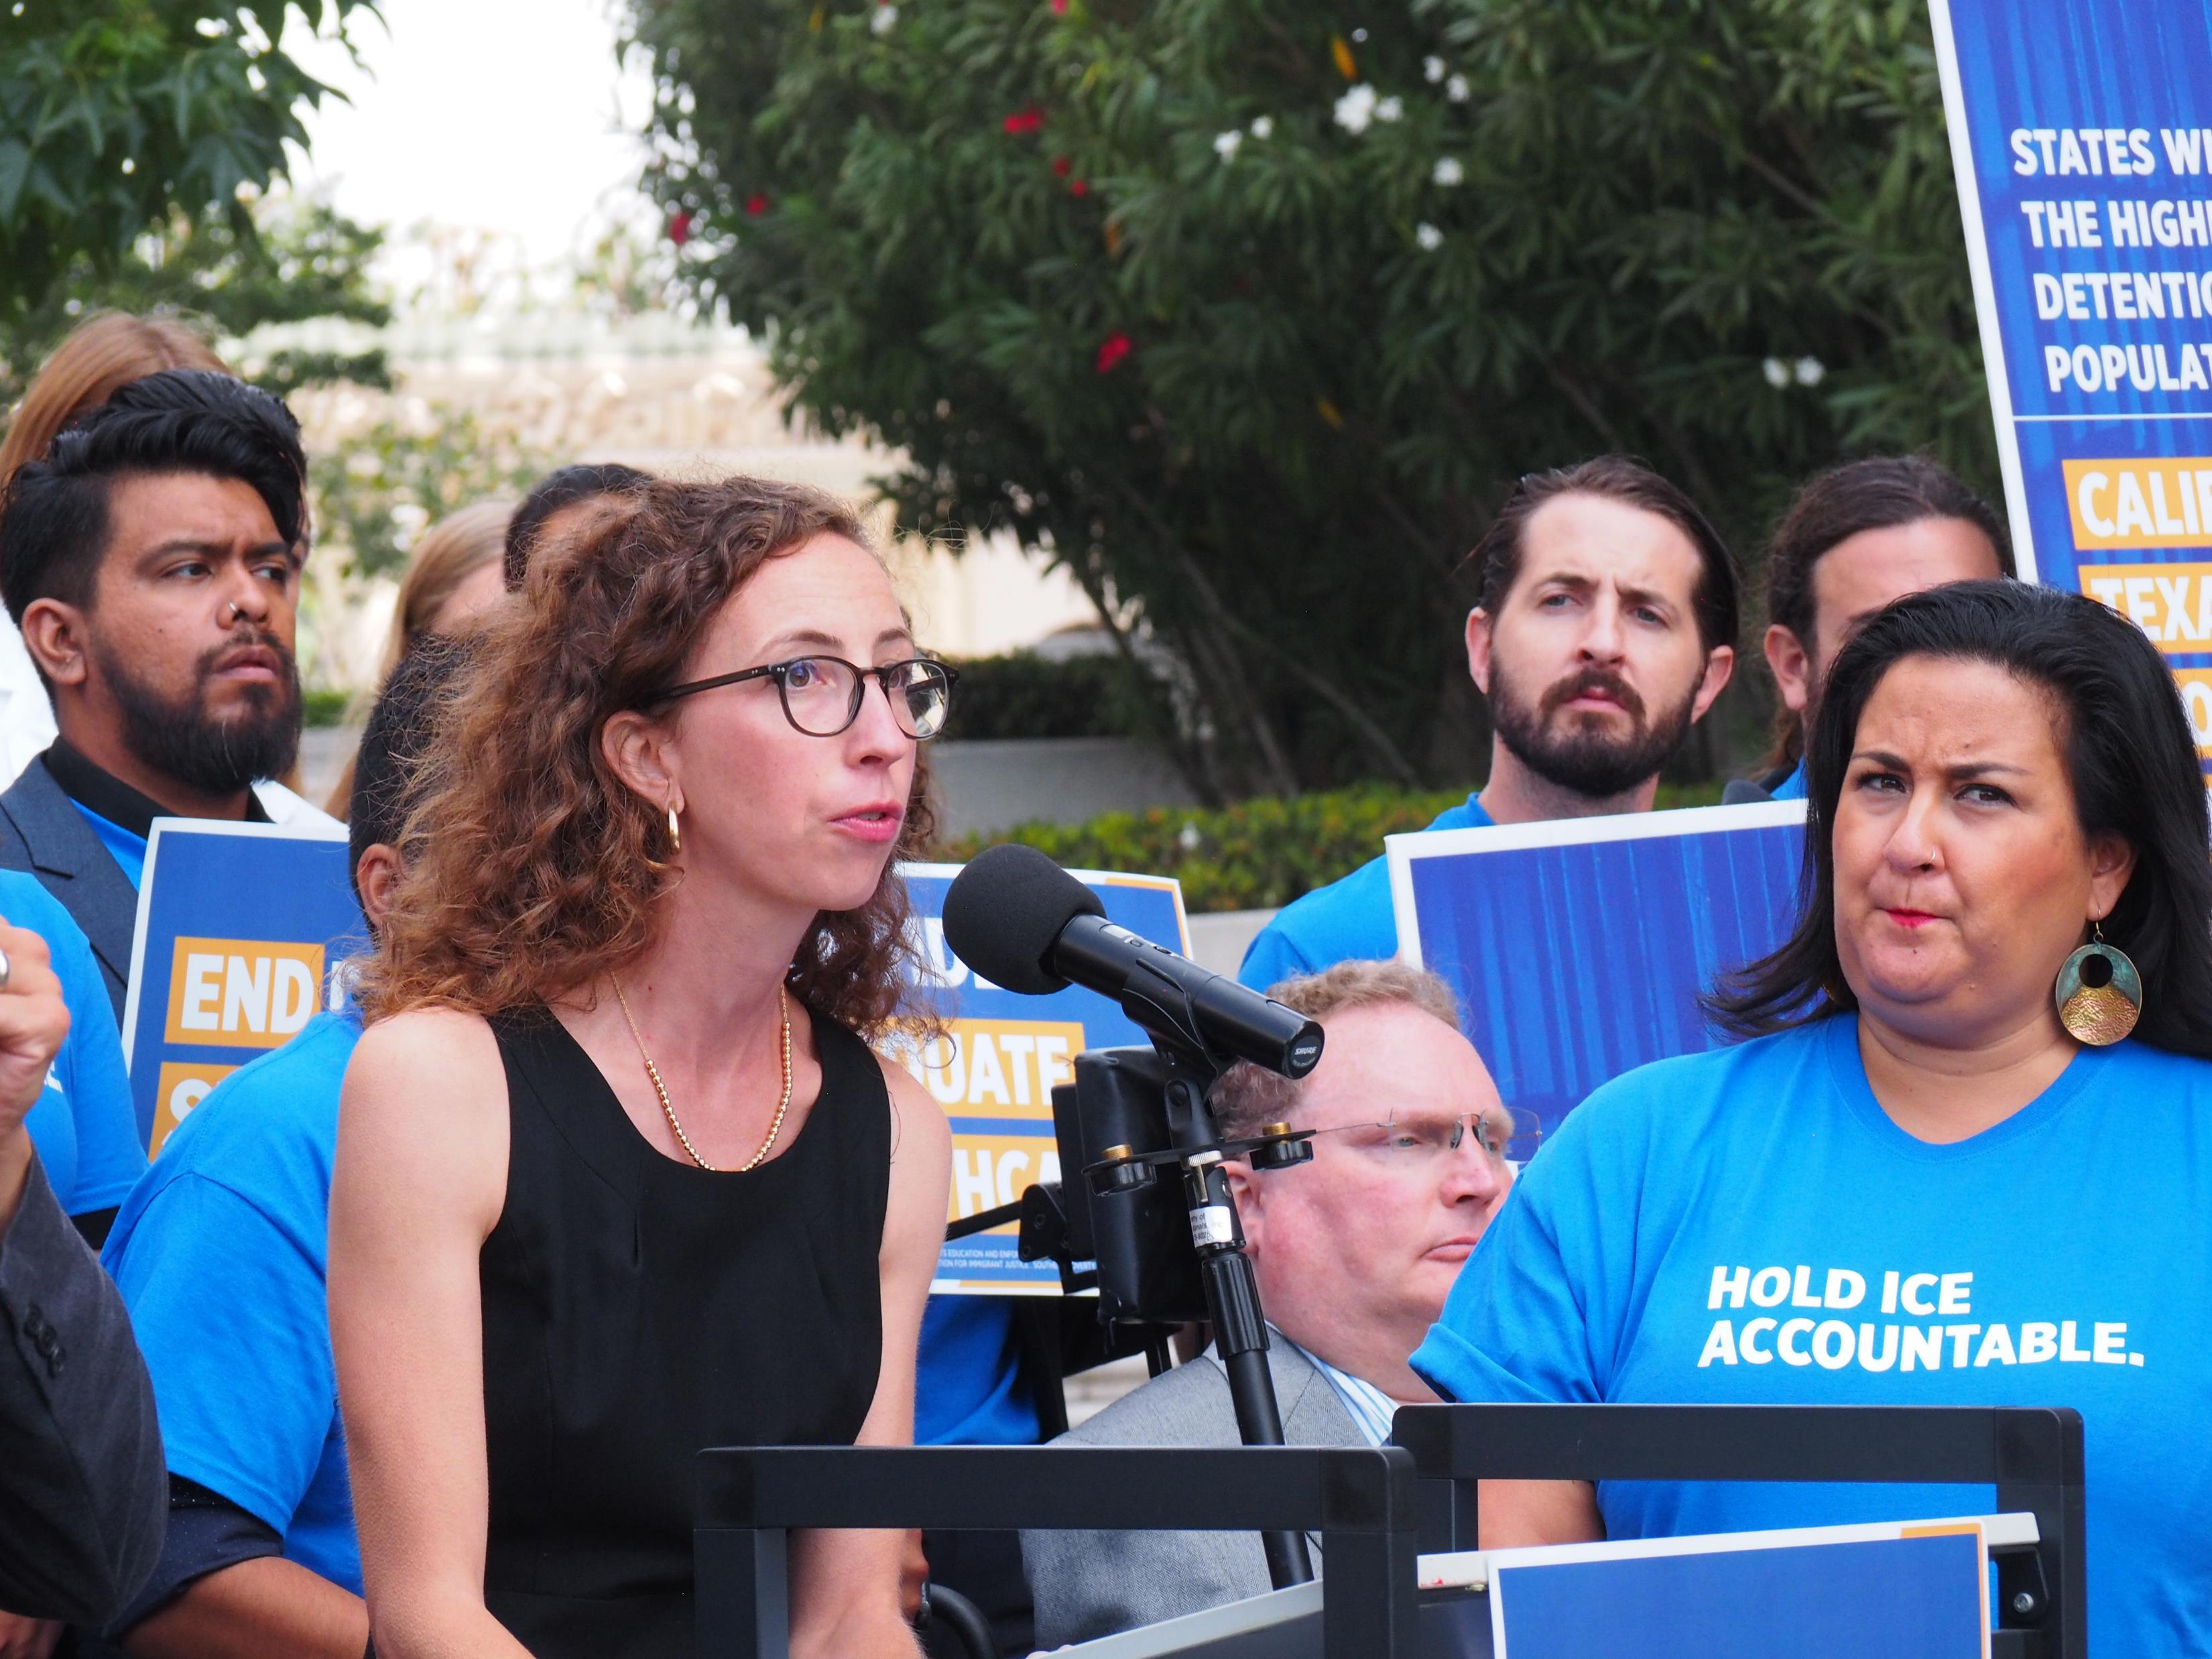
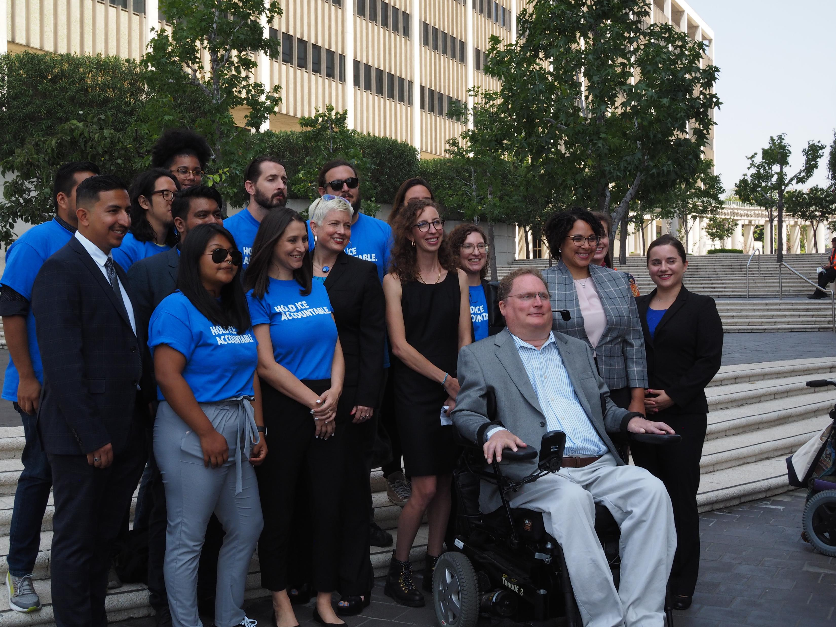
Fraihat v. ICE
August 19, 2019
Nationwide class action filed with co-counsel, DRA, SPLC, & Orrick, Herrington & Sutcliffe LLP. Fighting for appropriate medical and mental health care and disability rights for immigrants in detention.

Slide 20
Open Captioning at Broncos Stadium at Mile High – ready for the first pre-season game! August 29, 2019
Up next – Online video content captioning at major universities.
Stay tuned…

Slide 21
We think a two-tiered health care system with a racial bias is unfair. So we’re helping MALDEF and courageous plaintiffs challenge reimbursement rates in California’s Medicaid system.
photo credit to
Mike Chavez/SEIU-UHW
More on this to come...

Slide 22
Thank You.
CREEC’s work-- made possible by you.

Slide 23
Help CREEC continue to…
Challenge Discrimination
Donate today!
www.creeclaw.org/donate OR text “SupportCREEC” to 44321
Spread the word – forward our E-Newsletter!
Refer clients!

Slide 24
THANK YOU for Supporting CREEC!
ALL

Slide 25
Text-to-Donate m text “SupportCREEC” to 44321
Haven’t donated to CREEC yet?
or…
Would you like to give another gift?

