Slide 1
CREEC has so much to be thankful for!
As 2019 draws to a close, we take a moment to consider all that CREEC has to be thankful for.

Slide 2
We’ve Grown!
CREEC recently added:
Immigration Detention Accountability Project - 2018
Accessibility Project - 2019
Nashville Office - 2019
Development Office - 2019

Slide 3
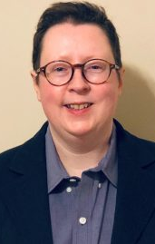
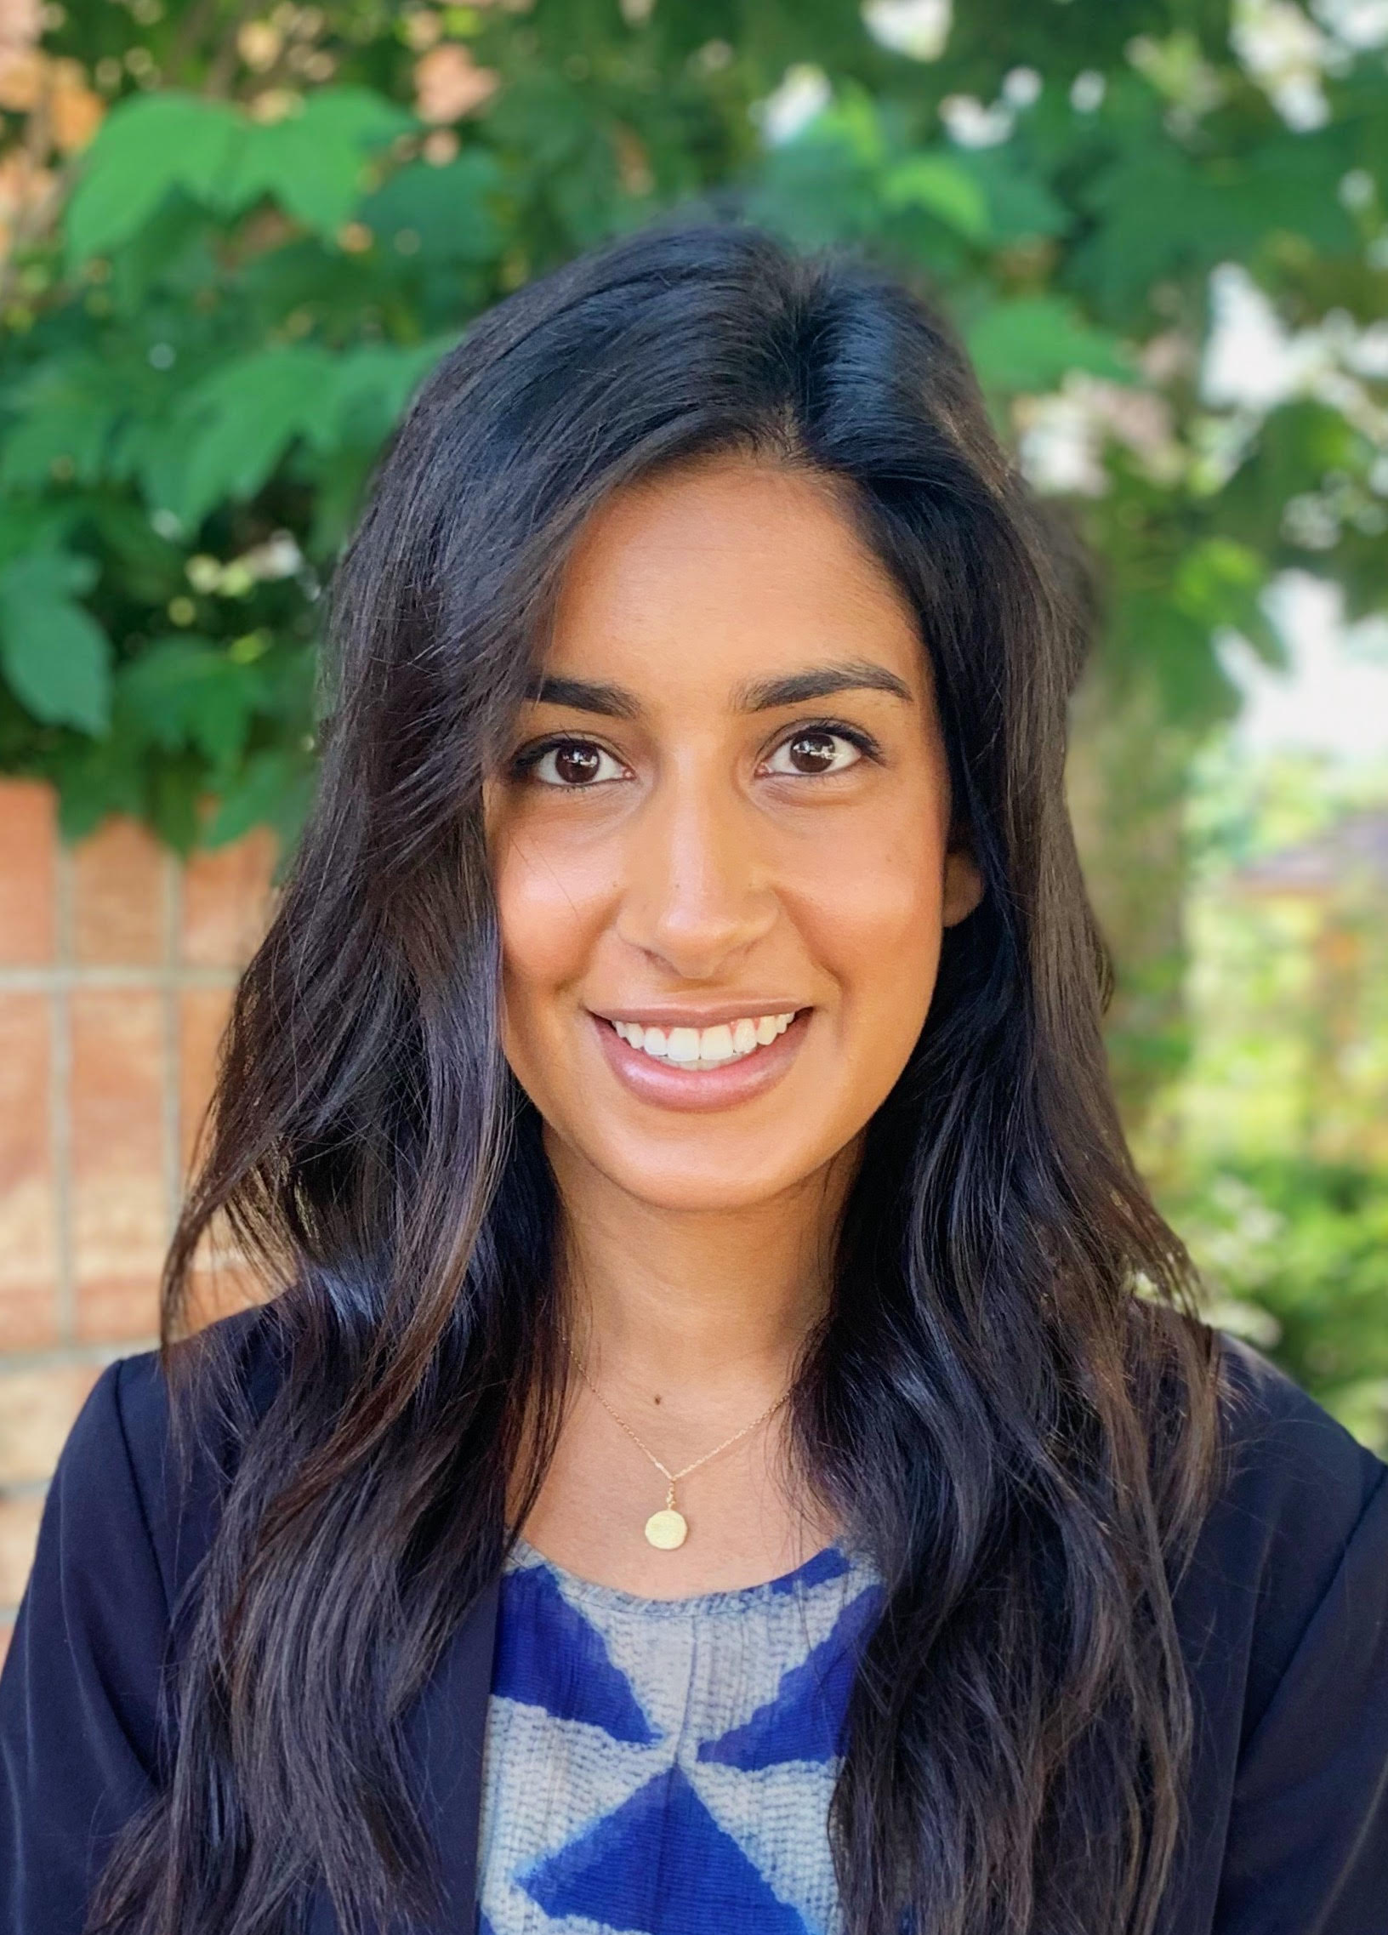
New to CREEC: Liz Jordan: Director of the Immigration Detention Accountability Project Martie Lafferty: Director of the Accessibility Project Julie Yates: Development Director Yashna Eswaran: Paralegal

Slide 4
We’ve outgrown our Denver office! New Space Coming Soon…

Slide 5
Where’s CREEC? Denver, Berkeley, & now Nashville, too!

Slide 6
Of course we’re always thankful for the office dogs.

Slide 7
We’re Thankful for our Great Cases, Clients, & Co-counsel!
Some of CREEC’s recent case highlights include...

Slide 8
Colorado Springs Agrees to Install over 15,000 Accessible Curb Ramps in the Next 14 Years.
March, 2019
Coming Soon – Boston and San Jose

Slide 9
CREEC Moves for Sanctions Against ICE
May 23, 2019

Slide 10
CREEC fights for the rights of Deaf immigrants in detention.

Slide 11
Sign Language Interpreters in Medical Settings
Did you know?
The Americans with Disabilities Act requires doctors and hospitals to provide Deaf people with “effective communication”.
CREEC does and helps others know it, too.

Slide 12
FAC
Fast
Advocacy for
Communication
Upcoming Event or Appointment?
Need Interpreter, CART, or other?
Told NO?
CREEC can help
Notes:
CREEC helps with multiple communication issues through our FAC program. The majority are barriers to communication at doctor’s offices and hospitals. I’m really excited about our FAC program because it lets us stop problems in their tracks. We work to make sure effective communication is provided so that Deaf people get the information they need. When we can, we love to help solve problems on the front end instead of filing lawsuits after the problem has harmed someone. (This doesn’t always work but does a high percentage of the time). This is when an interpreter or other communication aid is refused for an upcoming event or appointment. So, for example, maybe a deaf person makes an appointment with an attorney or doctor for next week and they say “no interpreter.” What can they do? Three Easy Steps.
Step 1: Contact CREEC at FAC@creeclaw.org or intakes@creeclaw.org
Step 2: Hire CREEC at no cost.
Step 3: CREEC writes a letter to educate and advocate.
Recent FAC results include: interpreters at multiple clients’ doctors appointments, interpreters at a hospital during a patient’s recovery after surgery, and interpreters for a rock concert

Slide 13
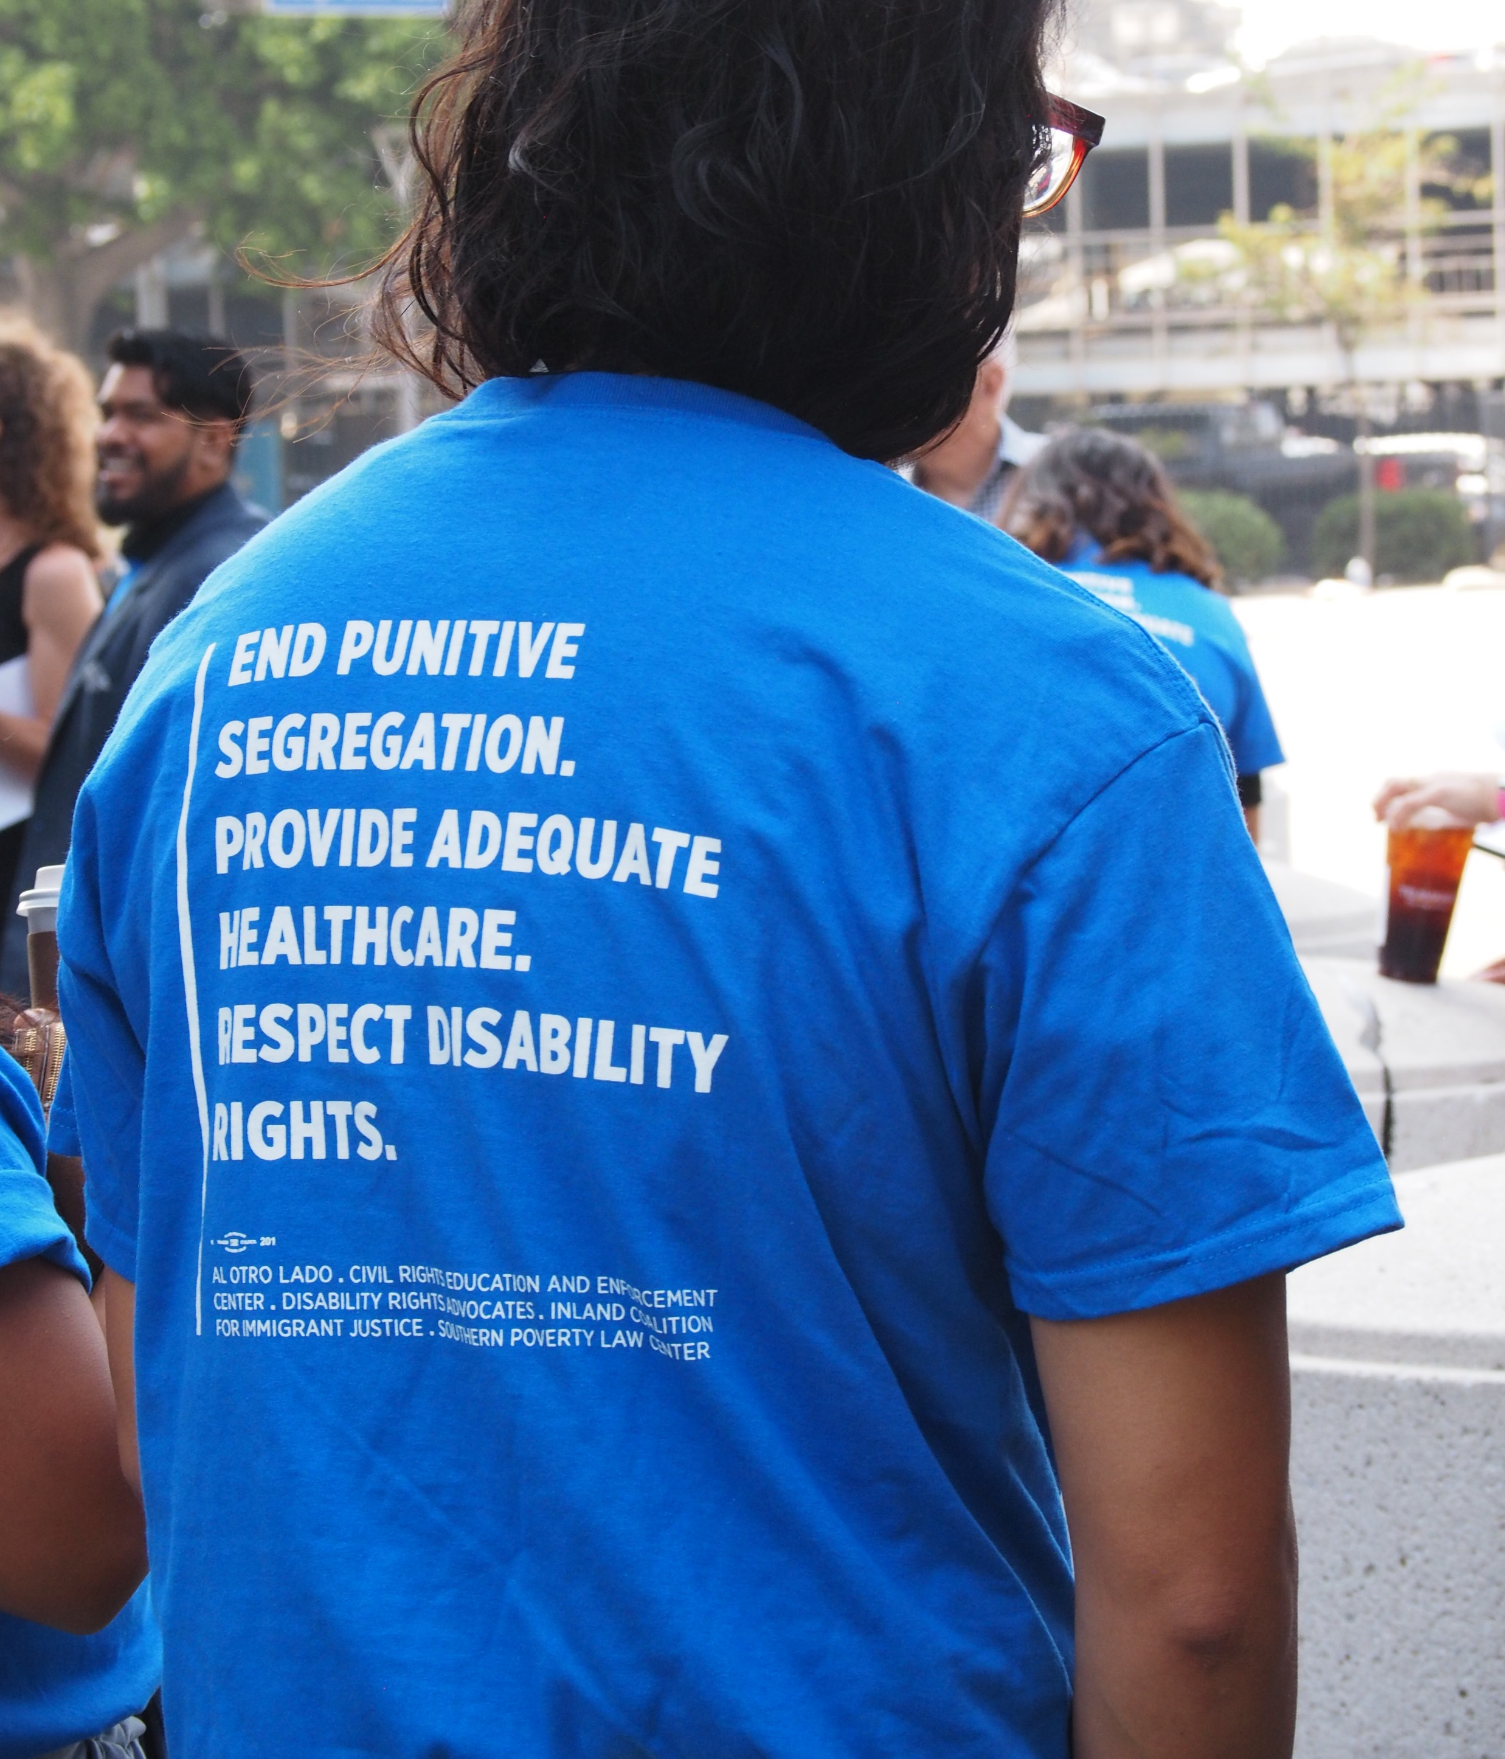
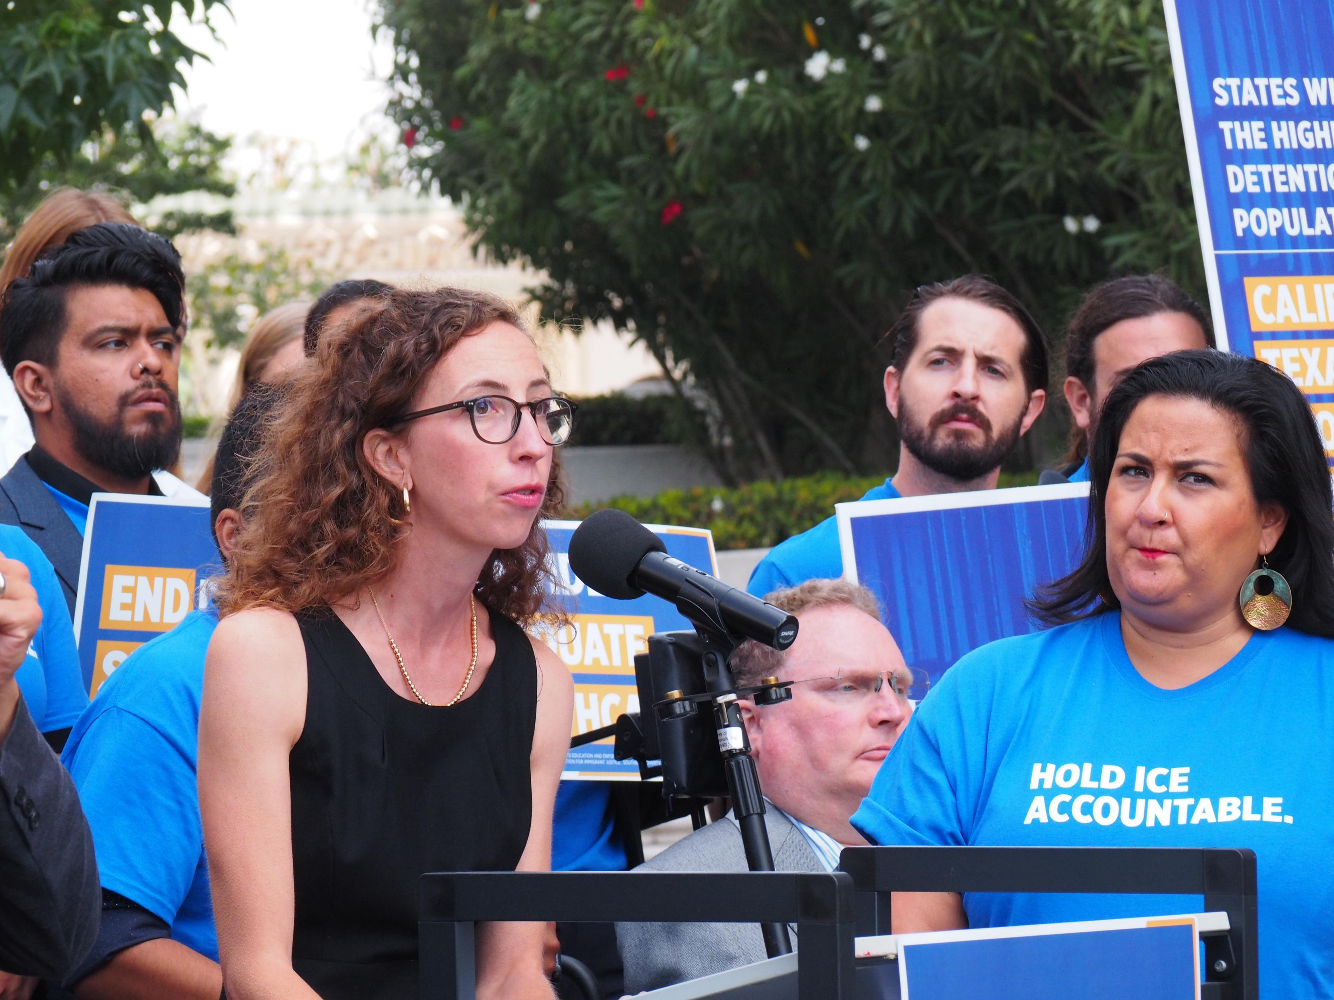
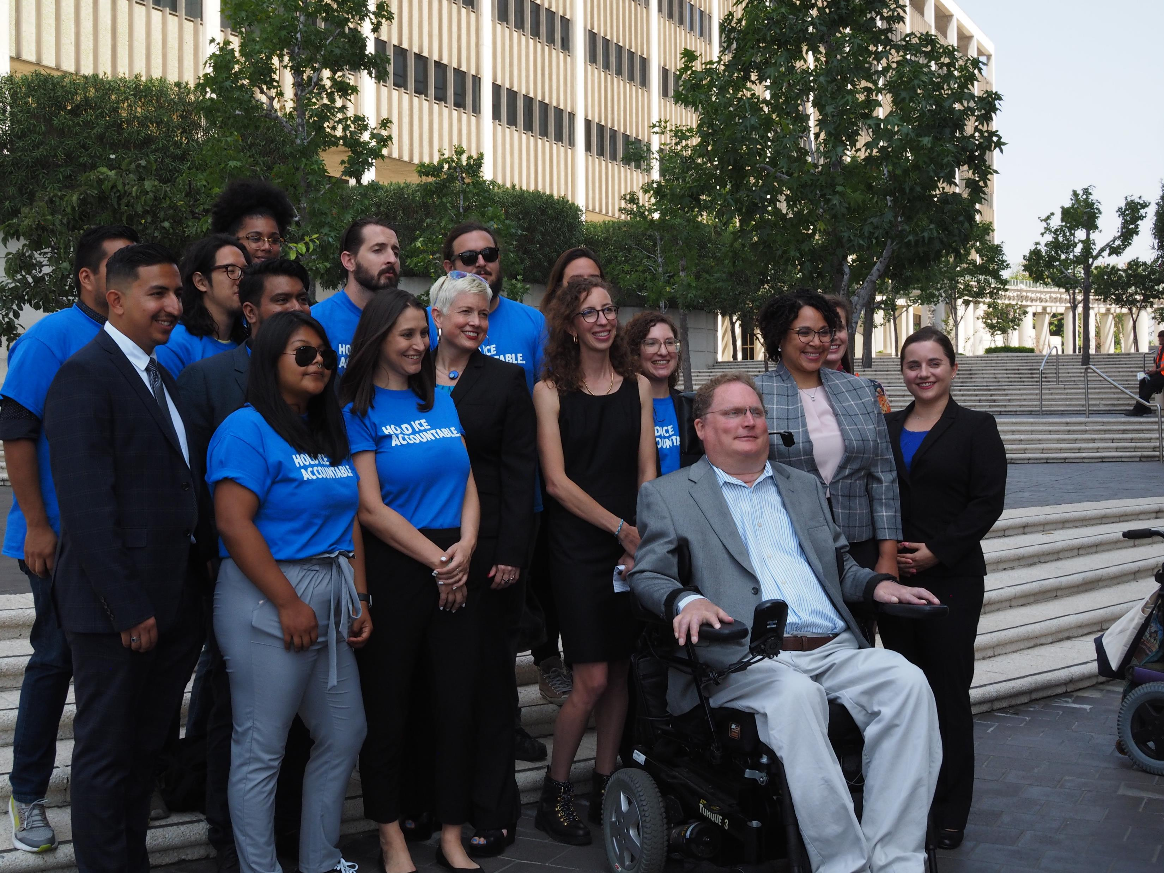
Fraihat v. ICE
August 19, 2019
Nationwide class action filed with co-counsel, DRA, SPLC, & Orrick, Herrington & Sutcliffe LLP. Fighting for appropriate medical and mental health care and disability rights for immigrants in detention.

Slide 14
Open Captioning at Broncos Stadium at Mile High – ready for the first pre-season game! August 29, 2019
Up next – Online video content captioning at major universities.

Slide 15
Summary judgement requiring the Colorado Department of Corrections to provide videophones to Deaf and hard of hearing prisoners and prisoners with DHOH family and friends.
November, 2019
Notes:
Rogers case—background-court’s ruling– VP is necessary for EC. TTY’s do not provide EC. We’re also investigating effective communications in other state prison systems—lack of (and unequal access to) VPs and also issues like failure to provide interpreters for communications such as doctor’s appointments, classes, and classification; using other inmates as “interpreters,” grievance info. only in written English, and no visual alarms. Investigations are revealing alarming details including –[share DT’s story re months of rehab classes with no terp.]

Slide 16
We think a two-tiered health care system with a racial bias is unfair. So we’re helping MALDEF and courageous plaintiffs challenge reimbursement rates in California’s Medicaid system.
photo credit to
Mike Chavez/SEIU-UHW

Slide 17
Impact
“Small but mighty”
Education
Teach “know your rights and advocate”
Inform providers, venue owners, municipalities
Resource for fellow lawyers and advocates
Enforcement
Class-action litigation
Litigation on behalf of organizational plaintiffs
Structured negotiations
Direct representation

Slide 18
And We’re Thankful for…YOU!
Thank You, CREEC Supporters.

Slide 19
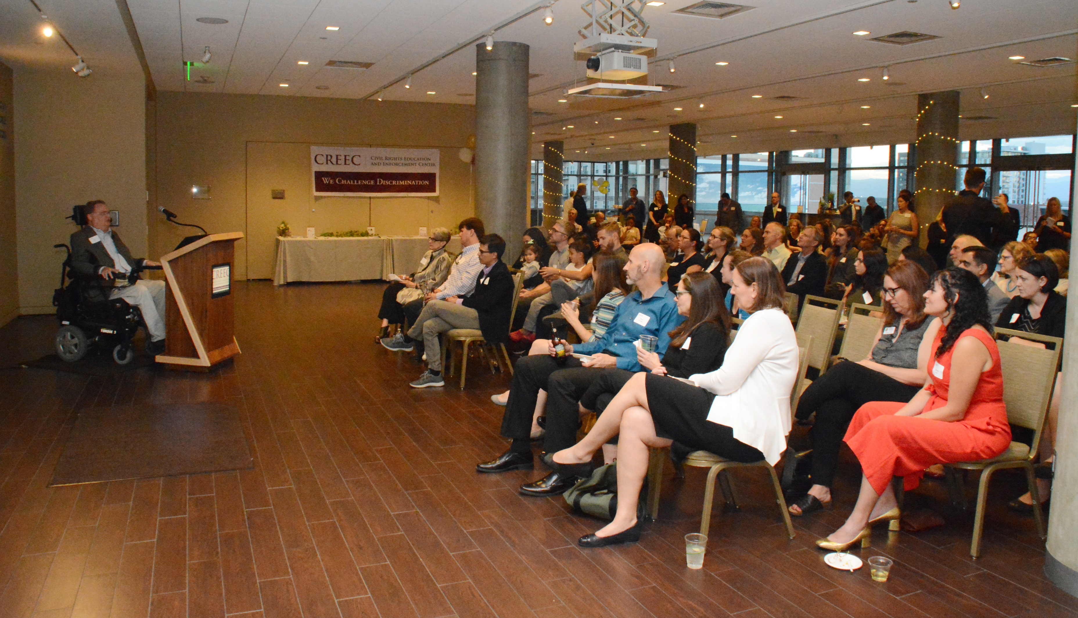
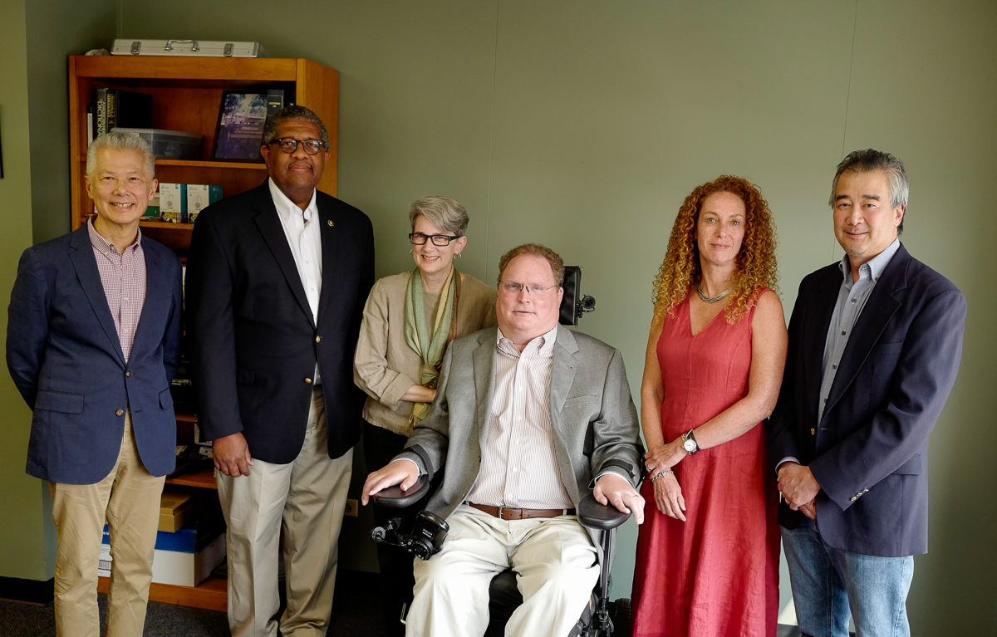
Support is on the Rise!
Expanding our reach
More than 2,000 people receive CREEC newsletters.
2019 Annual Event attendance doubled.
CREEC held an event in D.C. for the first time ever.
Social media fans are on the rise.
Growing our resources
2019 Annual Event sponsorship doubled.
2019 grant funding doubled.
Board of Directors’ giving is higher.
Gift totals to date are higher.
Number of CREEC donors is greater.
And we’re not done yet…!

Slide 20
Help CREEC continue to
Challenge Discrimination
Donate today!
www.creeclaw.org/donate OR text “SupportCREEC” to 44321
Spread the word – forward our E-Newsletter!
Refer clients!

Slide 21
THANK YOU for Supporting CREEC!
ALL

